Slide 1
Bayesian Analysis
By Tejaswi Tripathi

Slide 2
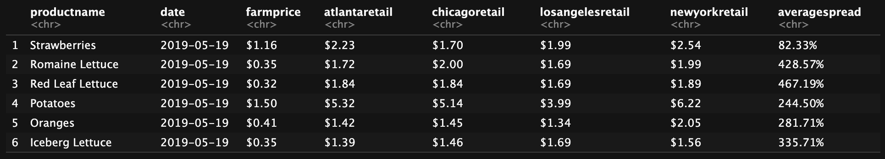
The Data
Our dataset contains 8 features. “Averagespread” refers to the amount that farmprice was marked up to retail price. Based on this, “averagespread” is a useful variable to predict.

Slide 3
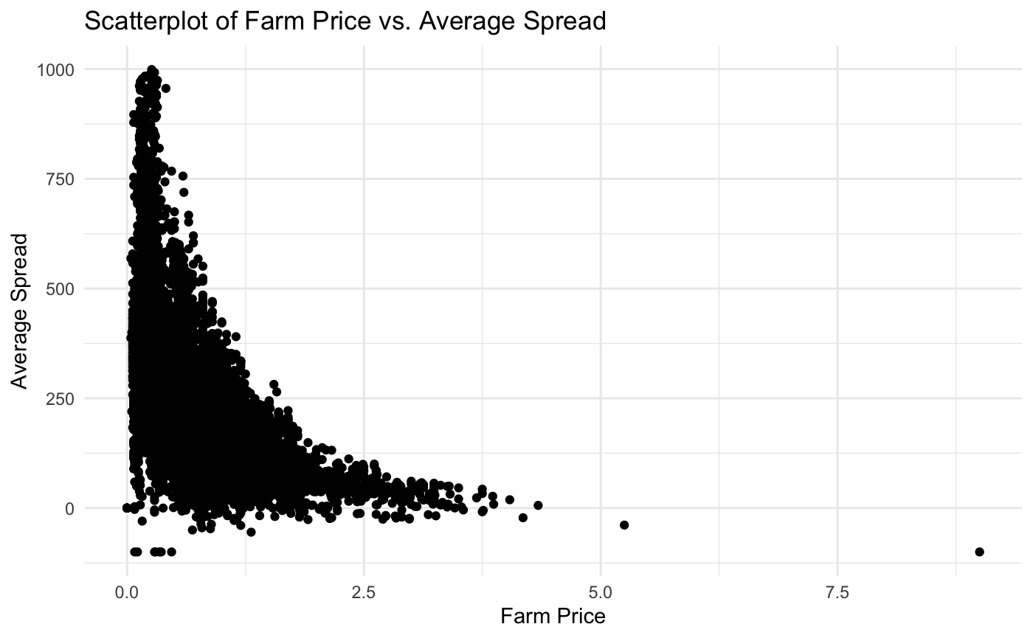
Exploratory Analysis
After performing some data cleanup, we plot “farmprice” vs “averagespread”:
We observe a clear trend resembling the graph y = 1/x. However, we can intuit that “averagespread” must also depend on the specific product, as each product would have a unique trend.

Slide 4
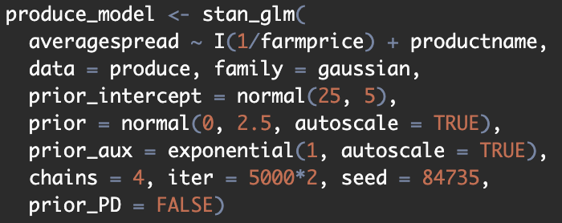
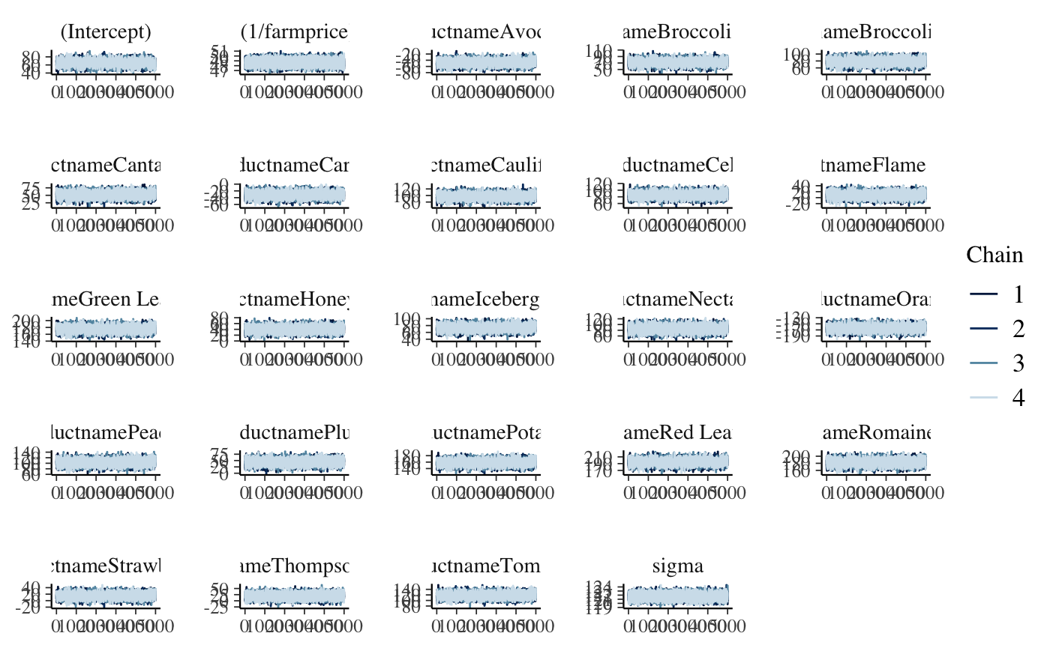
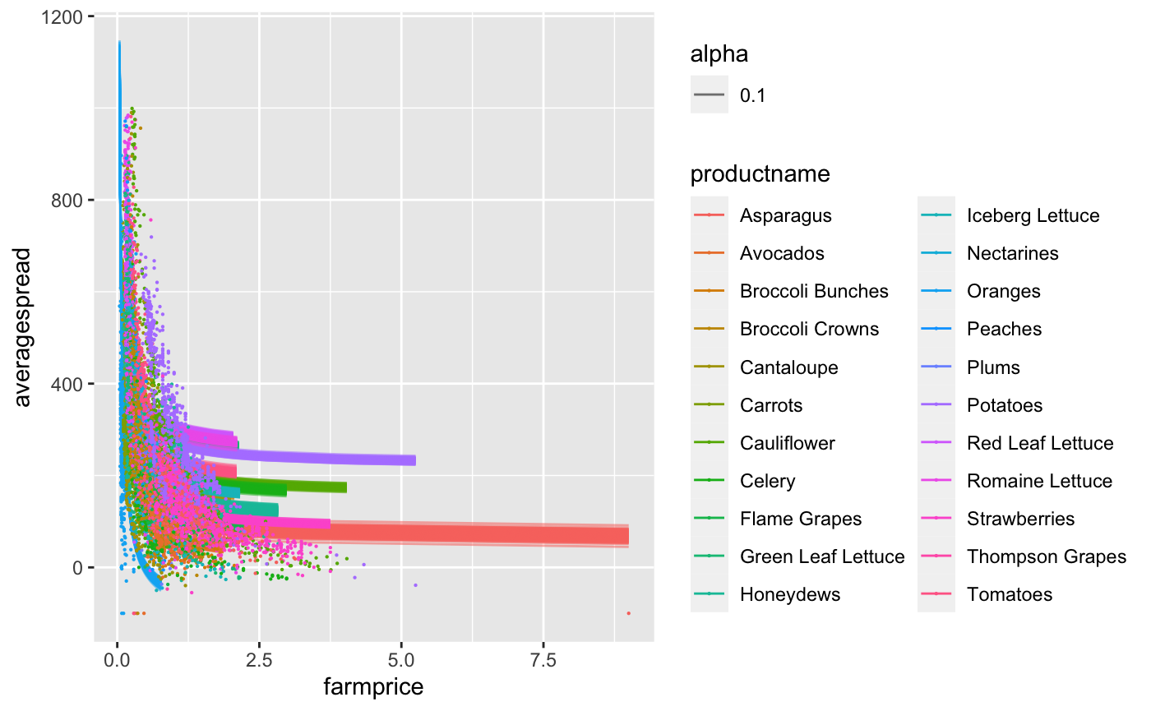
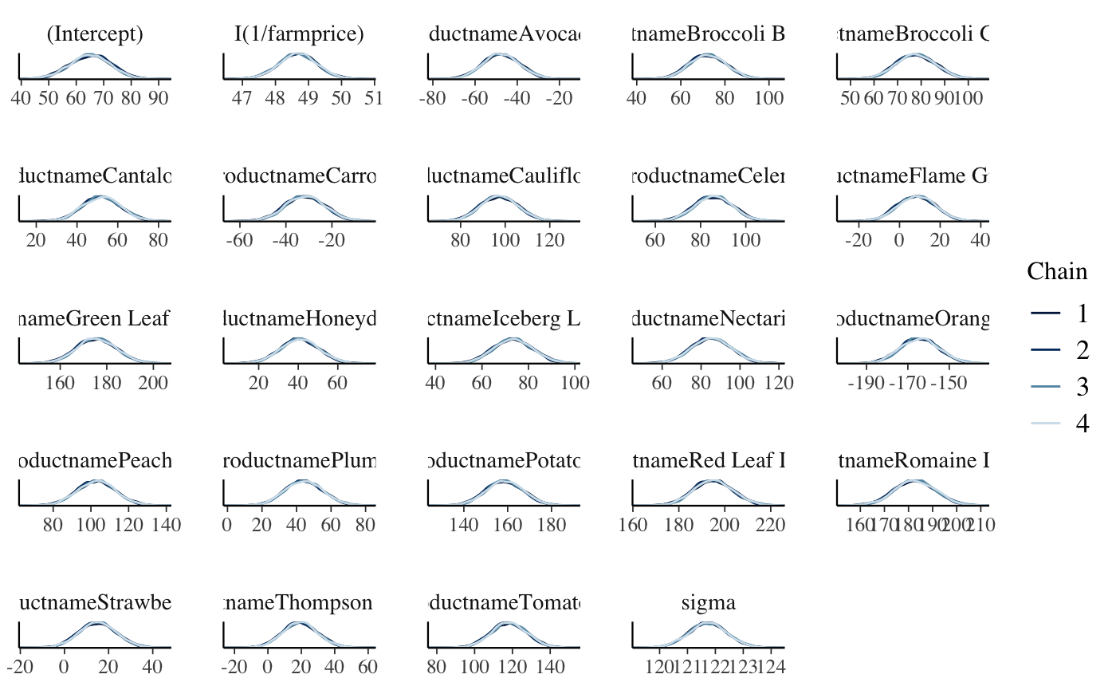
Model 1: Linear
All neff_ratios and rhats are within proper bounds.

Slide 5
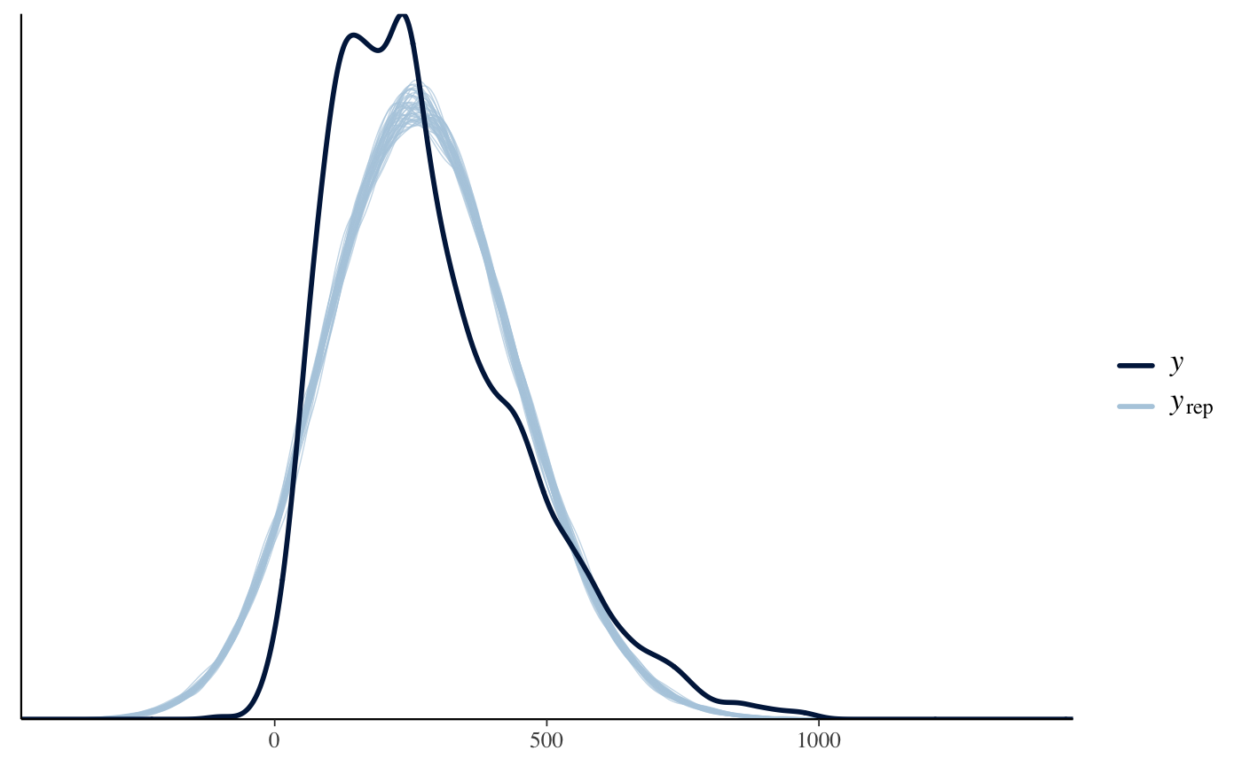
Posterior Predictive Check 1
This model may not be as accurate as we hope. Perhaps another model would make more sense.

Slide 6
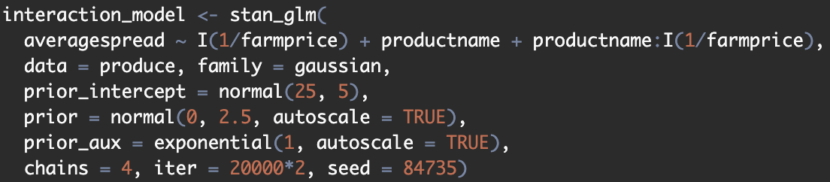
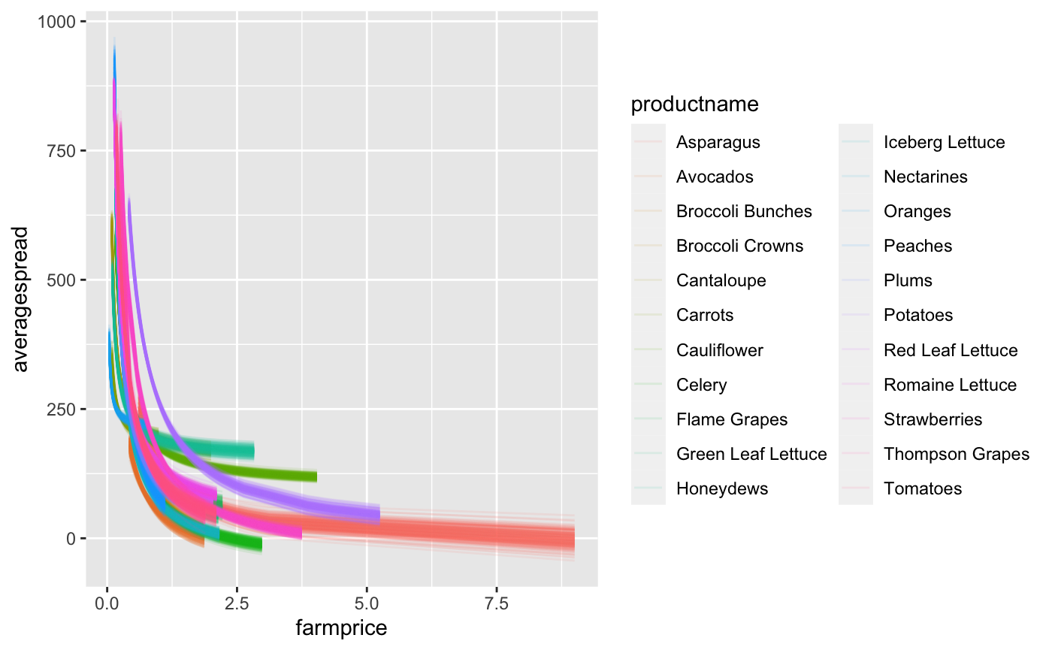
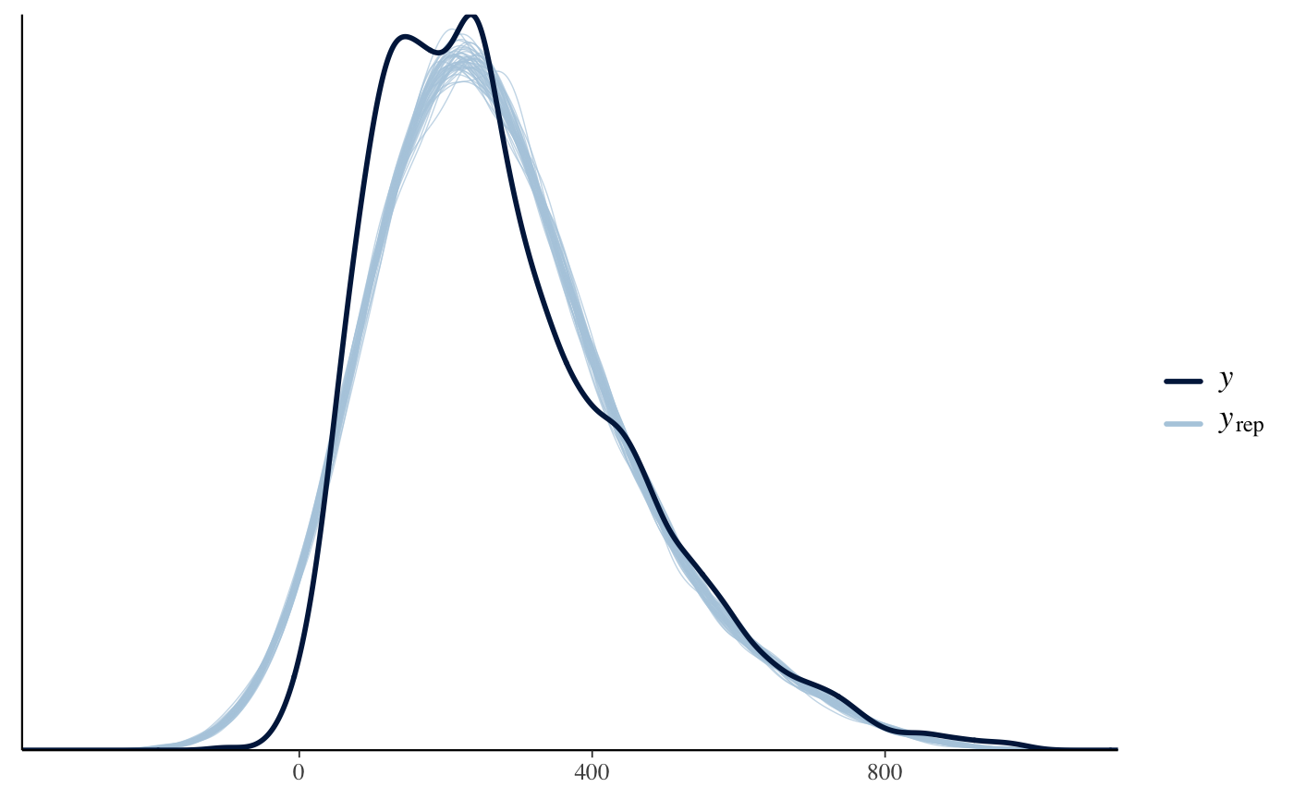
Model 2: Interaction + Posterior Predictive Check 2
Very few of the neff_ratios were within the proper bounds, which leads to suspect the quality of the MCMC. However, since the rhats were all good, we continue.

Slide 7
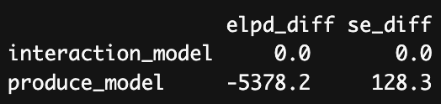
Predictive Accuracy
Running loo_compare, we find that the interaction model performs significantly better against the data than the linear model does. This can be explained by the fact that the trend of the scatterplot changes depending on the productname. Each product has a unique relationship between farmprice and averagespread, so it makes sense that the interaction model would perform better.

Slide 8
Improvements?
One strong improvement we could make is to use a hierarchical model, which will have fit one model for each product. Additionally, it’s possible that some products may be irrelevant to the overall trend; in this case, it would have been useful to implement a random forest regression model or a PCA to find the products that influence averagespread the most.

